Slide 1



MARC
Branding Proposal
OPT 1
Utilize brand material

Slide 2
Table of contents
GENERAL INFORMATION
ACTIVITIES PROPOSAL
Club Piaf TRY Free
Branding Post
Tips Website
Facebook Minigame
Voucher Redeem at store
Activity Timeline by Month
Service Budget & KPI

Slide 3
A.
General Information

Slide 4
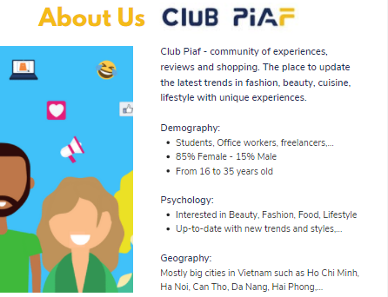
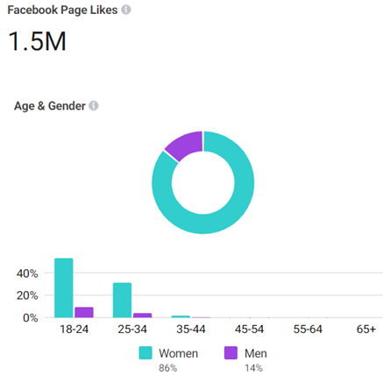
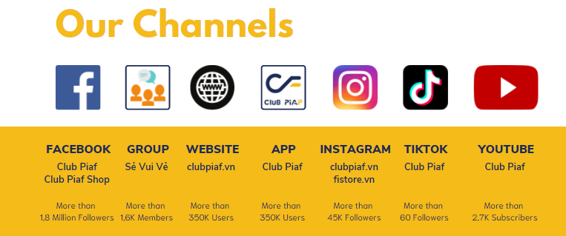
With TA base, in which 18-34 year old account for the highest number, Club Piaf is suitable for MARC to introduce product

Slide 5
B.
Activities Proposal

Slide 6
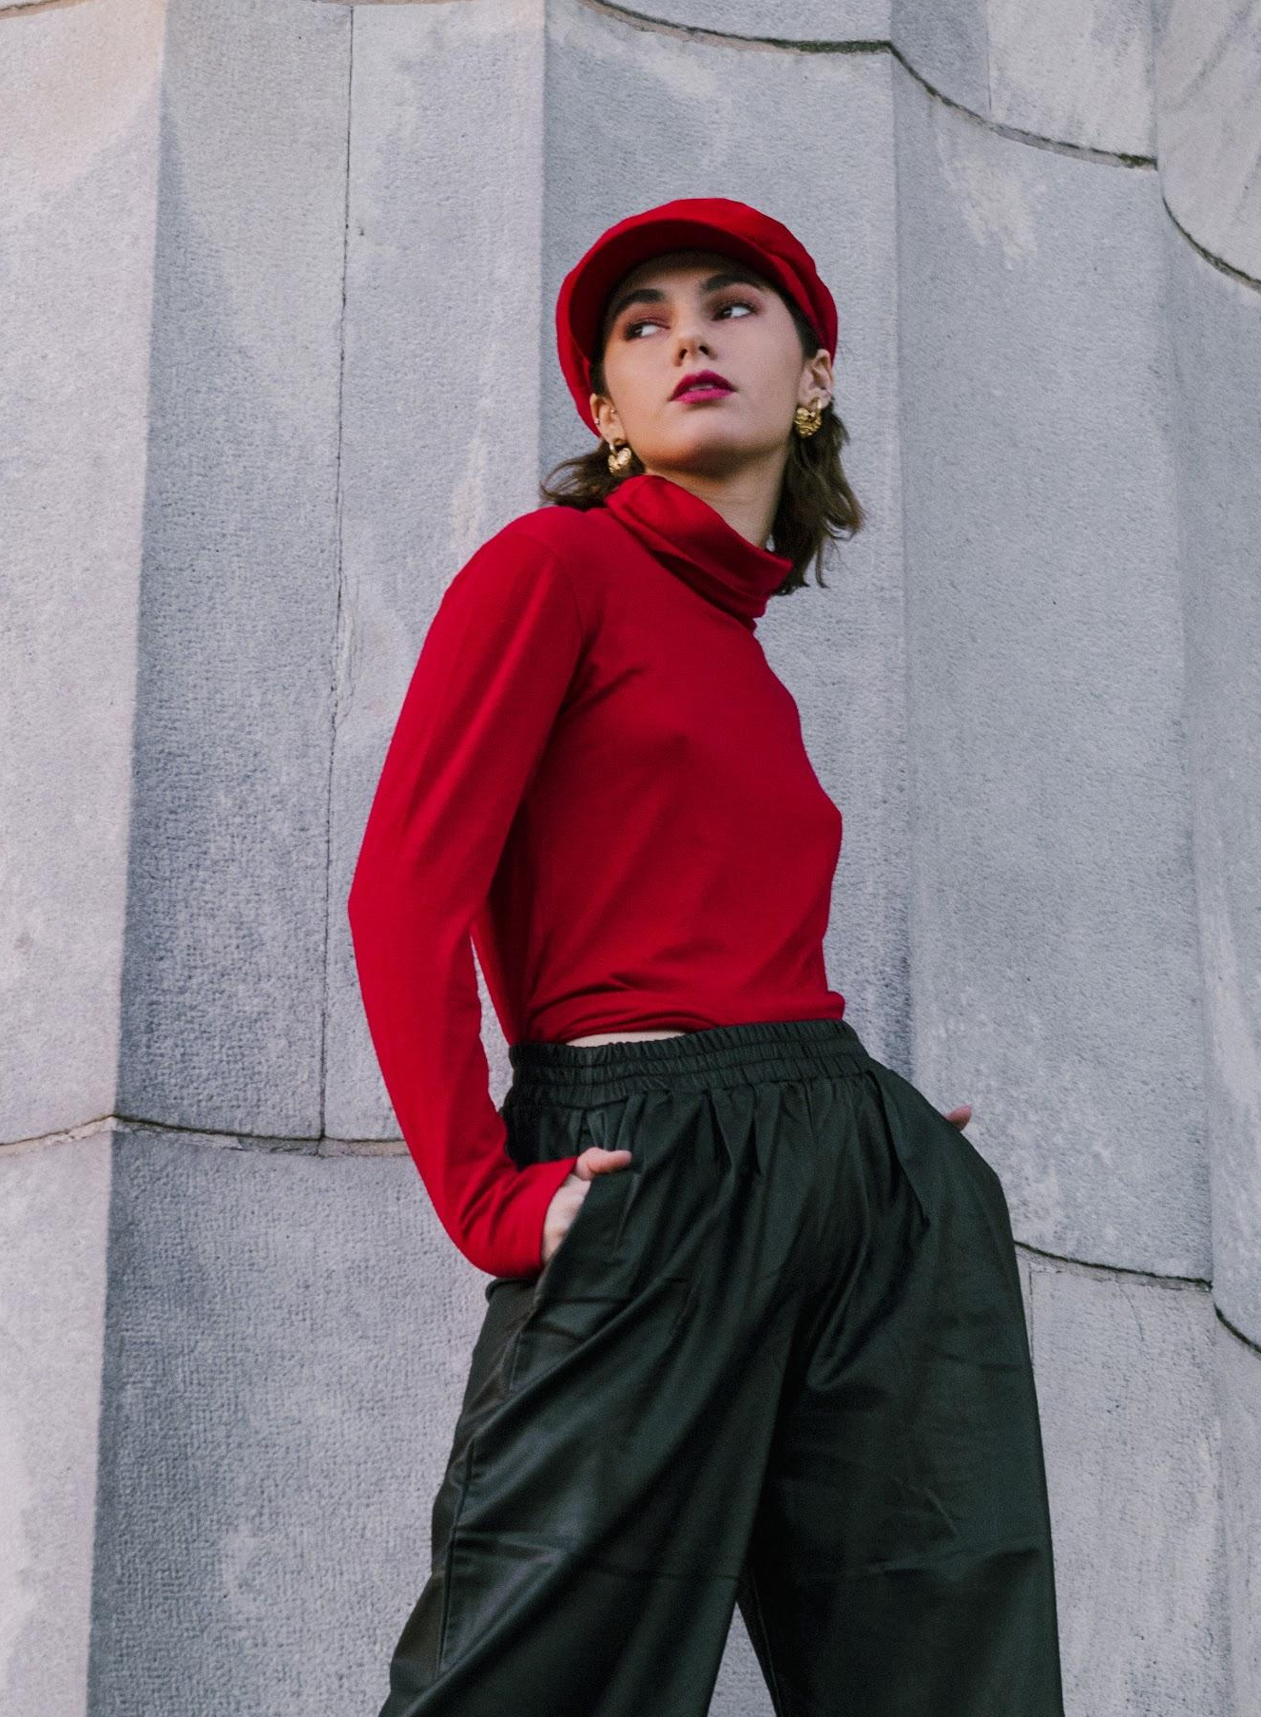
01
Club Piaf
TRY Free
An activity, in which customers can have chance to try the products then give authentic reviews
To amplify the influential power of consumer reviews and support brand to reshape the way to market your products

Slide 7
Try Free Process
1
2
3
4
Brand provide products or vouchers for
TRY Free
Brand receive proposal
and give feedback
TRY Free phase 1
(for 3 days)
TRY Free on website
+ Remind TRY Free post on Facebook
TRY Free phase 2
(for 3 days)
TRY Free on website
+ Remind TRY Free
post on Facebook
5
6
7
8
Branding post(s)
on Facebook
Choose WINNERs based on brand or
Club Piaf criterias
Send products to WINNERs for experience
Winners review products
Brand receive TRY Free Report (digital report will be included)

Slide 8
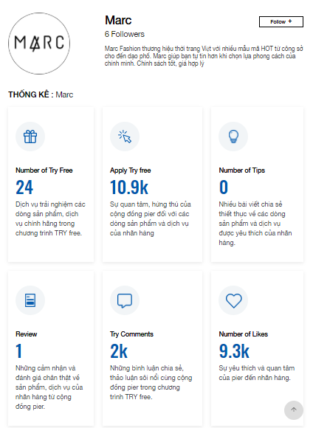
Try Free Overview
10,963
TRY Free Registration
9,251
Total Likes
2,034
Total Comment

Slide 9
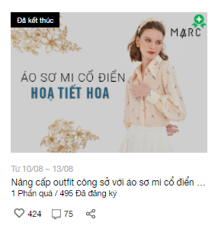
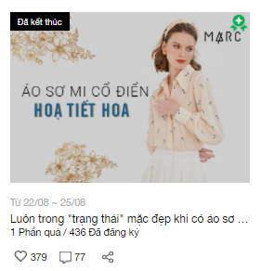
Try Free Display on Website
PHASE 1
PHASE 2
Start/ End Date
TRY Free Registers
TRY Product Quantity

Slide 10
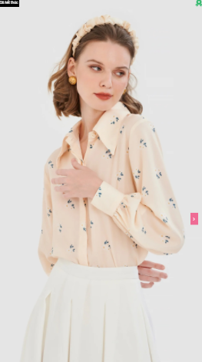
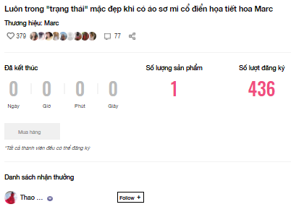

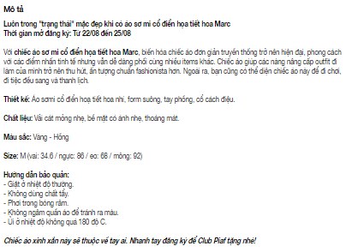


Try Free Display on Website
TRY Free Registers
WINNER/
List of WINNERs
1. Try Free Description will be included:
- Product information
- Product highlights
- How-to-use
- Official website, fanpage
2. TRY Free product will be aired on website for 3 days for user to click “Register”
Detailed Images

Slide 11

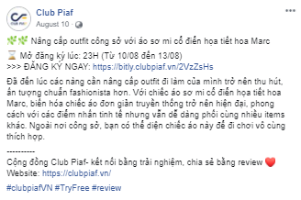
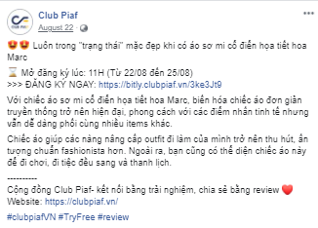
Try Free Remind Display on Fanpage
Remind 1
Remind 2

Slide 12

02
Branding Post
An activity, in which brand’s products will approach a community of 1.5 million customers.

Slide 13




Content Direction
Branding Post 1: Lookbook
Loạt thiết kế thời thượng nhà MARC khiến giới mộ điệu bao ngày thổn thức
Branding Post 2: Mix & Match
“Giải mã” công thức phối đồ ko lỗi mốt

Slide 14

03.
Tips Website

Slide 15

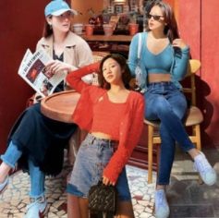
Tips Content
Option #1:
XU HƯỚNG
Mãn nhãn với loạt trang phục trendy “khuynh đảo” những cô nàng sành mốt
Option #2:
MIX&MATCH
Cuộc hôn phối của sự thanh lịch và tinh thần trẻ trung
Option #3:
Diện gì để luôn Tự tin & Khác Biệt
Notes:
Offer thêm đi báo kênh khác

Slide 16
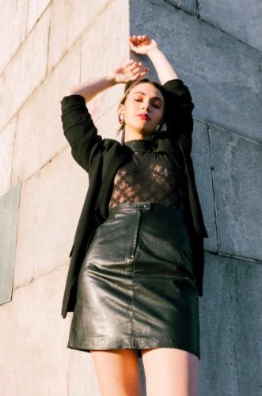
04
Minigame
An activity, in which brand’s products will engage with a community of 1.5 million customers.

Slide 17

Minigame Rule
- Player shares Minigame post with #brand_hashtag to their FB account in public mode.
- Player guesses which box contains MARC logo then comment the number gift box in the comment section.
- Player tags 2 friends
***Note: All Pier will receive 10% discount voucher at store when they join minigame. Extra 20% discount at store from 22 to 28/11
Purpose
To increase product awareness
Timeline
(TBC)
Winner
(TBC)
Gift Quantity
(On Brand’s request & package)

Slide 18
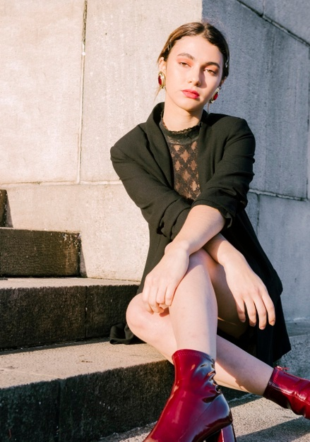
05
Voucher Shop
An activity, in which Brand & Club Piaf will issue vouchers for customers to redeem at brand’s stores.
To enhance brand awareness and increase the purchase intention.

Slide 19
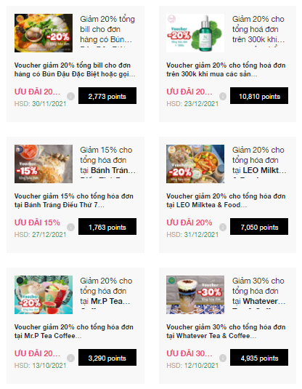
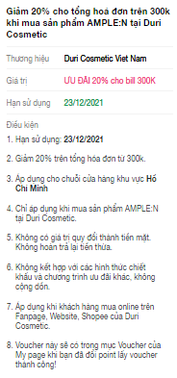
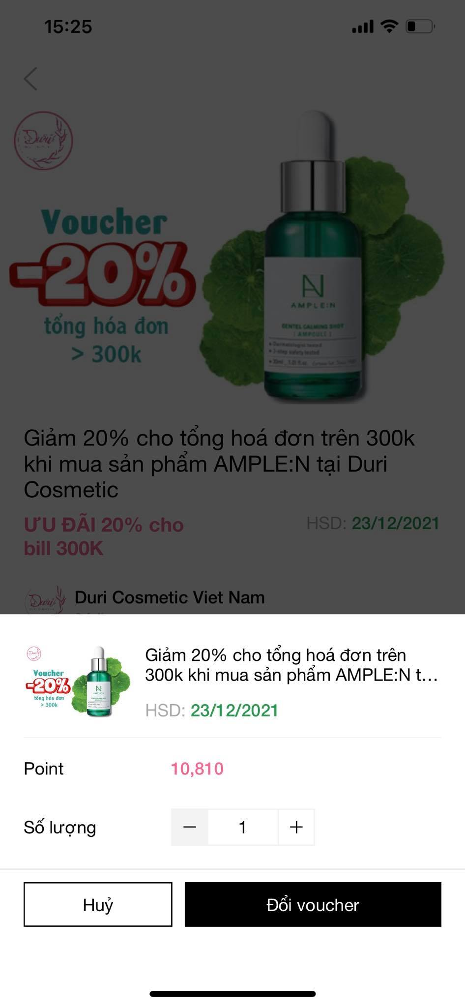
Voucher Shop Display
Discount 20% on store purchase
Redeem vouchers at MARC stores
Website

Slide 20

ACTIVITY
Timeline

Slide 21
ACTIVITY TIMELINE by MONTH
November 2021
No | Social Post Design sent back to MARC 03 prior to posting date | Date
1 | Try Free - Phase 1 from 01/11 to 04/11 | On Air: 11:00 AM 01/11 Remind: 10:30 AM 01/11
2 | Branding Post 1 - Lookbook | 04/11
3 | Branding Post 2 - Mix & Match | 09/11
5 | Tips Website | 12/11
6 | Try Free - Phase 2 from 16/11 to 19/11 | On Air: 8:00 PM 16/11 Remind: 7:30 PM 16/11
9 | Minigame | 22/11 to 28/11
10 | Voucher Redeem Function | 01/11 to 30/11

Slide 22

SERVICE BUDGET
& KPI

Slide 23
SERVICE CHARGE
No. | Activity | Quantity | Service Unit Cost (VND) | Total Service Cost (VND) | Digital Ads (VND) | TOTAL Service & Ads (VND) | KPI
1 | Branding post | 02 | 2,000,000 | 4,000,000 | 6,000,000 | 10,000,000 | 4,000 Engagement
2 | TRY Free from SNS | 02 | 3,000,000 | 6,000,000 | 4,000,000 | 10,000,000 | 1,000 CTW
3 | Minigame | 01 | 4,500,000 | 4,500,000 | 3,000,000 | 7,500,000 | 2,000 Engagement
4 | Tips Website | 01 | 2,000,000 | 2,000,000 | 1,000,000 | 3,000,000 | 750 CTW
8 | Voucher Redeem Function (Free of charge) | 01 | 3,000,000 | 3,000,000 | 500,000 | 0 | 350 Engagement
9 | Digital Ads 5% FCT | 01 | _ | _ | 725,000 | 725,000
10 | Agency fee 5% | 01 |  |  |  | 1,561,250
Total (-VAT) |  |  |  |  |  | 32,786,250

Slide 24
THANK YOU

